Slide 1

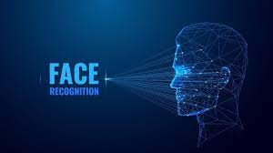

Face Detection Using ML
AI-FEST
Project Evaluation
Group Leader: Sarmad Ahmed
Group member: Hania Hasan
Group member: Hafsa Shahab
Group member: Mustafa Khan
Instructor: Mr Zahid Hussain
Industry Partner: Usman Ali
Department of Computer Science - DHA Suffa University

Slide 2


Summary
Project Brief Introduction
Problem Statement
Dataset Description
Project Scope
ML/DL/NLP Model Details
Results and Discussions
Tools and Technologies Learnt During the Project Implementation (Individual Skills Set)
Project Demo
References (last accessed)

Slide 3
Project Brief Introduction
Project Name: Face Detection Using ML
Description: This project aims to develop a facial recognition system capable of identifying individuals from static images. It involves analyzing facial features and matching them against a predefined dataset to recognize authorized faces. The project targets security and law enforcement, access control systems, and financial services in the Pakistani context.

Slide 4
1- Problem Statement
Objective:
To create a facial recognition system that identifies
individuals from static images using machine learning techniques.
2. Significance:
Security and Law Enforcement: Aid in identifying suspects
and locating missing persons.
Access Control Systems: Enhance security by verifying identities in sensitive areas.
Financial Services: Improve security measures for online banking and financial transactions.
Scope: The project focuses on static image recognition rather than real-time video streams or facial expressions. Initially, it will target a limited dataset of known individuals.

Slide 5
2- Dataset Description
Pakistani Faces Dataset:
The dataset comprises of Pakistani individuals..
Face Detection:
Utilizing OpenCV Haar-cascades to automatically detect and crop facial regions from images.
Feature Extraction:
Using wavelet transforms to capture detailed facial features and textures. This involves decomposing images into various frequency components to extract meaningful features that improve recognition accuracy.
Challenges:
Handling variability in lighting conditions Not clear eyes and ensuring consistency in image quality and resolution for reliable feature extraction and model performance.

Slide 6
3- Project Scope
Tools Used: OpenCV library for face and eye detection.
Methods: Extract facial features using wavelet transforms to capture essential characteristics.
Algorithms: Train and evaluate Support Vector Machine (SVM), Logistic Regression, and Random Forest models.
Optimization: Use GridSearchCV to fine-tune hyperparameters for each model to achieve the best performance.
Output: Save the best-performing model to a file for deployment.
Flask Server: Us eof Flask server for deployement
Purpose: Build a Python Flask server to handle HTTP requests from the user interface.
UI Development:Create a user interface using HTML, CSS, JavaScript, and jQuery for image upload and user interaction.

Slide 7
4- ML/DL/NLP Model Details
Support Vector Machine (SVM):
Usage: Robust classification of facial features.
Advantages: Effective in high-dimensional spaces, versatile in different kernel functions.
Logistic Regression:
Usage: Efficient binary classification of facial recognition.
Advantages: Simple implementation, interpretable results.
Random Forest:
Usage: Handling complex decision boundaries in facial recognition.
Advantages: Handles large datasets with higher dimensionality, reduces overfitting through ensemble learning.
Techniques Employed:
Data Preprocessing: Using OpenCV for face and eye detection.
Feature Extraction: Applying wavelet transforms to extract relevant features.
Hyperparameter Tuning: GridSearchCV for optimizing model performance.

Slide 8
5- Results and Discussions
valuation Metrics:
Accuracy: Overall performance of the model in correctly identifying faces.
Precision: The ratio of true positive identifications to the total identified positives.
Recall: The ratio of true positive identifications to the total actual positives.
F1 Score: Harmonic mean of precision and recall, providing a balanced measure.
Comparison of Models:
SVM: Performance metrics, strengths, and limitations.
Logistic Regression: Evaluation results and comparison with other models.
Random Forest: Effectiveness in handling complex datasets and its performance metrics.
Best Performing Model:
Highlight: Identify the model with the highest performance and explain why it outperformed others.

Slide 9
6- Tools and Technologies Learnt During the Project Implementation
OpenCV: For computer vision tasks like face and eye detection.
Scikit-learn: For building and evaluating machine learning models.
Flask: For creating web servers to handle HTTP requests.
HTML, CSS, JavaScript, and jQuery: For developing the user interface for image upload and interaction.
GridSearchCV: For hyperparameter tuning to optimize model performance.
Wavelet Transforms: For feature extraction from facial images.

Slide 10
7-Project Demo
Description: Demonstrate the facial recognition system developed.
Steps:
Upload Image: User uploads an image via the interface.
Face Detection: System detects and highlights faces in the image.
Feature Extraction: Extracts facial features from the detected faces.
Model Prediction: The system uses the best-performing model to identify the individual.
Result Display: The result is displayed to the user with relevant details.
Key Features:
Accuracy: High accuracy in identifying individuals.
User Interface: Simple and intuitive UI for easy interaction.
Performance: Efficient and fast processing of images.

Slide 11
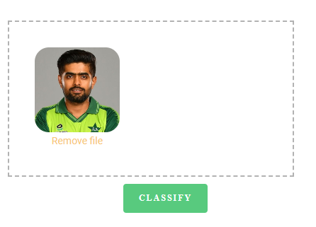
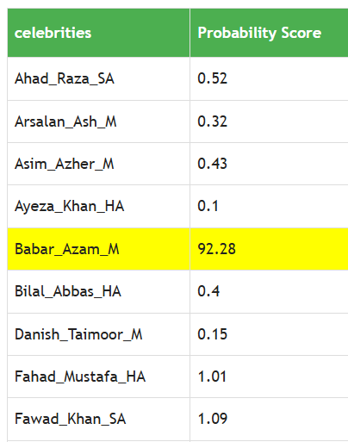
8- Project Outcome

Slide 12
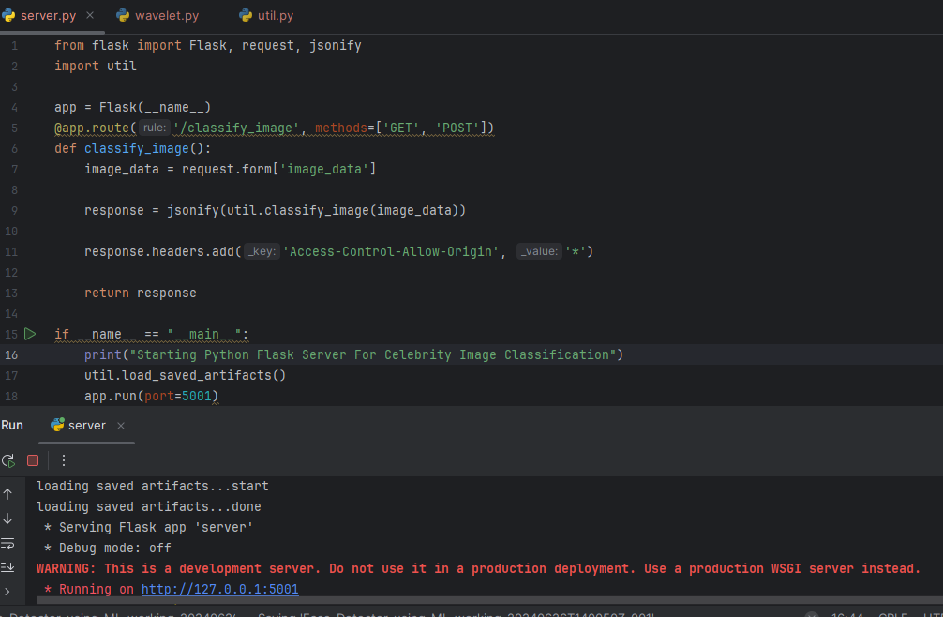
9- Flask Deployment

Slide 13
10- Reference
Datasets were publicly collected from Google by extracting celebrities images using Fatcun in form of batches.

Slide 14

11- The End

